Slide 1
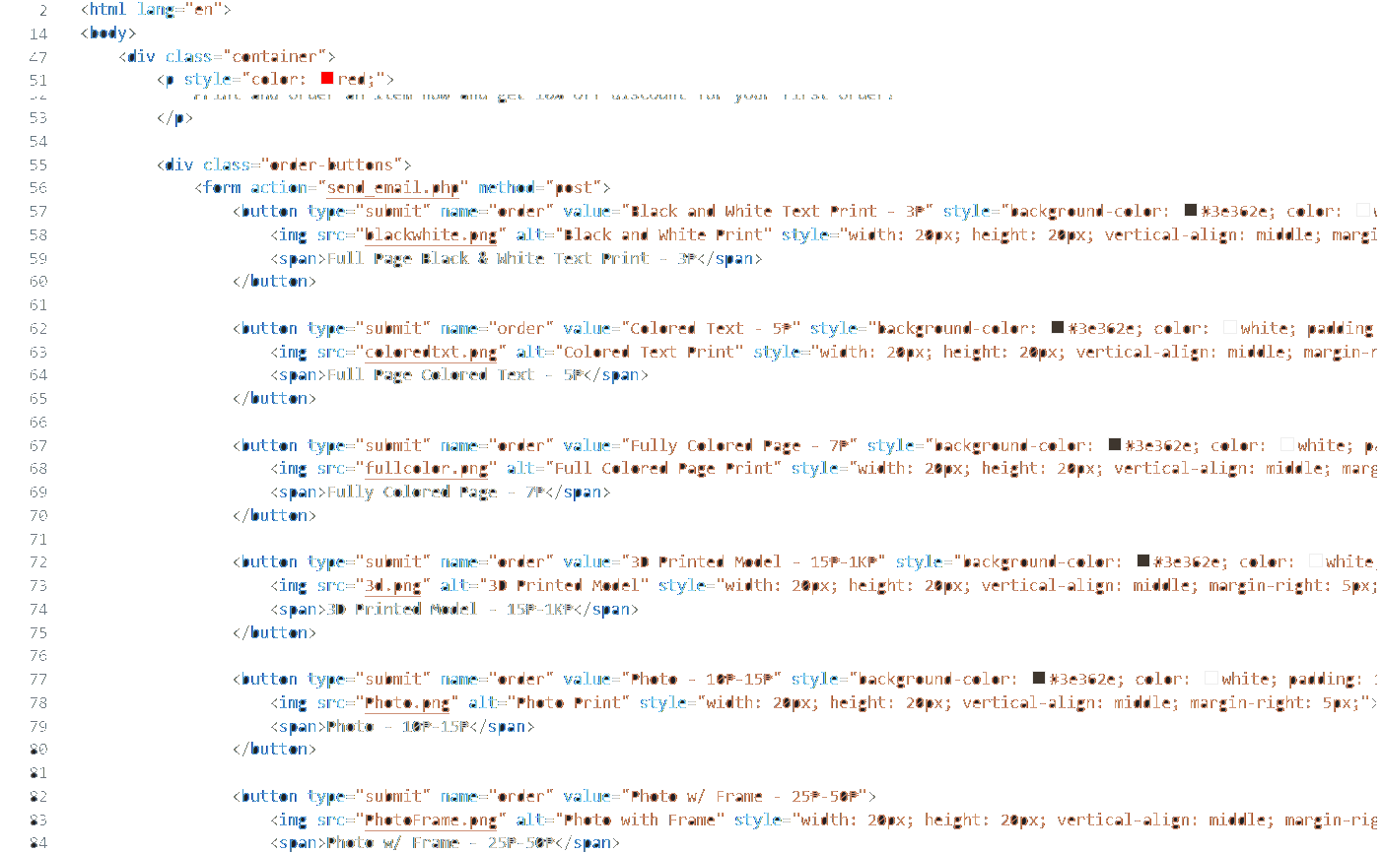

Prints
WEBPAGE PROJECT FOR ICT

Slide 2
LM Prints:High-quality prints through your artwork.
Welcome to LM Prints—where your ideas come to life! We are your one-stop shop for all things printing, right in the heart of Tagum City, Philippines. Whether you need prints that captivate, communicate, or celebrate, we’re here to make it happen with unmatched quality and flair. Lewis Miguel Baldelovar founded LM Prints with a bold vision: to revolutionize the printing experience by combining cutting-edge technology with a personal touch. In just a few short months, we've already made waves in the community, becoming the go-to destination for anyone who values creativity, precision, and excellence. At LM Prints, we don’t just print—we transform your artwork into high-quality masterpieces. From business branding that stands out to personal projects that tug at the heartstrings, we’re all about making your prints as unique as you are. Imagine your ideas, brought to life with the kind of detail and vibrancy that leaves a lasting impression. What sets us apart? It’s our passion, our dedication, and our relentless pursuit of perfection. We’re not satisfied until you’re thrilled with the results. Every project, big or small, gets our full attention and expertise. Because at LM Prints, we believe that your success is our success. Join the growing number of satisfied clients who’ve discovered the LM Prints difference. Whether it’s for a special event, a marketing campaign, or just because, we’re ready to exceed your expectations and make your vision a reality. Thank you for choosing LM Prints. Let’s create something amazing together!

Slide 3
Vision
To become the leading provider of printing services in the region.
To continuously innovate and offer the best pre-order printing experience, tailored to our customers' unique needs.

Slide 4
Mission
To deliver exceptional printing services that exceed customer expectations.
To provide seamless pre-order processes that ensure timely and accurate delivery of customized products.
To foster long-term relationships with our clients by consistently delivering quality and reliability.

Slide 5
Core Values
Quality: We prioritize excellence in every print, ensuring that our products meet the highest standards.
Customer Focus: We are committed to understanding and meeting the specific needs of our customers.
Innovation: We continuously seek new ways to enhance our printing processes and services.
Reliability: We promise timely and dependable service with every order.

Slide 6
Why LM Prints?
Top-Notch Printing: We utilize the latest technology to deliver crisp, vibrant, and durable prints.
Personalized Service: Every project is tailored to meet the unique needs of our clients.
Seamless Pre-Order Experience: We offer a smooth and straightforward pre-order process, ensuring that you receive exactly what you need, when you need it.

Slide 7
Services
Custom Printing: From business cards to banners, we provide a wide range of customized printing solutions.
Pre-Order Printing: Plan ahead with our reliable pre-order system, guaranteeing availability and timely delivery.
Design Assistance: Need help with your design? Our team is here to support you every step of the way.

Slide 8
Join Us on Our Journey!
Experience the difference with LM Prints.
Let us help you bring your ideas to life with our high-quality printing services.
Contact us today to start your next project!

